Slide 1
REGIONAL PRIORITIES
Q1 2019

Slide 2
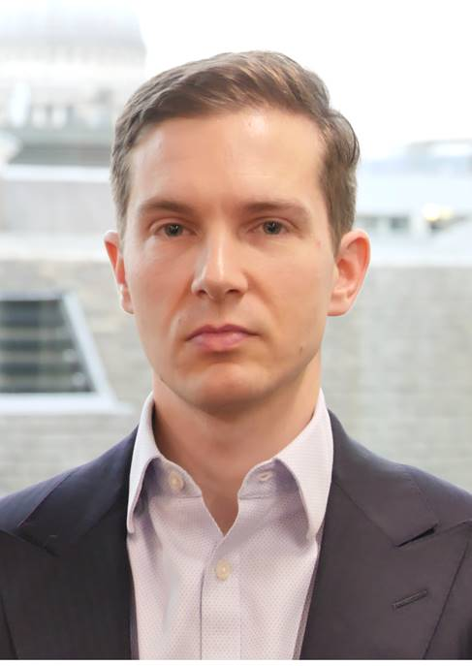
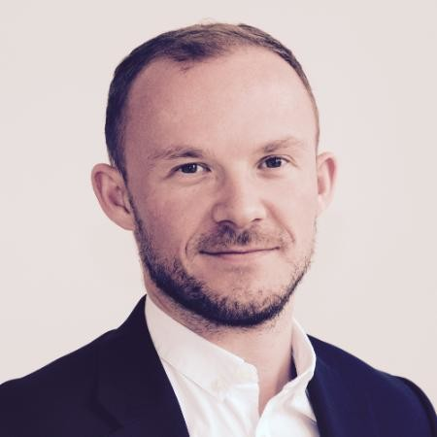

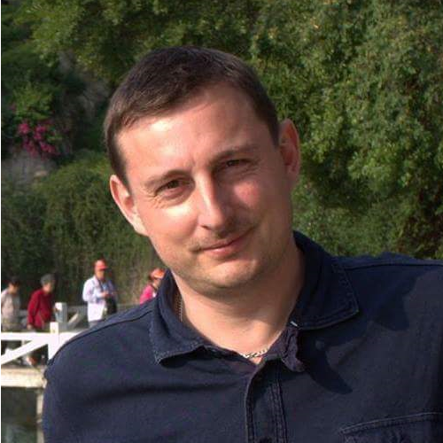
Regional priorities: Please get in touch to discuss further
It is increasingly important all regions share in the UK’s prosperity and ensure no areas falls behind.
We have set out progress against 2019 regional priorities. These priorities serve as starting points as we shape local industrial strategies across England and strengthen regional stakeholder relationships.
The deliverables outlined here are not exhaustive of the work we are undertaking, and we will continue to find opportunities to act on behalf of members. We would welcome your views so please get in touch to discuss the plans or other business priorities in further detail with the relevant senior regional policy adviser.
Jim Hubbard
Head of Regional Policy
Jim.Hubbard@cbi.org.uk
James Sloan
Regional Senior Policy Adviser
South West and East of England
James.Sloan@cbi.org.uk
Hannah Richmond
Regional Senior Policy Adviser
North West, North East, Yorkshire and the Humber
Hannah.Richmond@cbi.org.uk
Mark Corbett
Regional Senior Policy Adviser
West and East Midlands
Mark.Corbett@cbi.org.uk

Slide 3
Q1 2019: North wesT
Local Industrial Strategies
Made submission to Greater Manchester Combined Authority (GMCA) Industrial Strategy call for evidence, calling for a renewed focus on the key drivers of productivity: skills, infrastructure, business practices and exports within the strategy, as well as more detail on the role for the Grand Challenges within the local industrial strategy (LIS), and maximising the opportunity to outline future plans for further devolution within the region. The CBI is continuing to work closely with the GMCA as they develop this and other key strategies which will influence long-term policy making in the region and evidence the calls for further devolution.
Damian Waters met Chair of Liverpool, Cheshire and Warrington, Manchester and Cumbria LEPs, to reinforce key messages from the CBI’s submissions where applicable, and offering support in business engagement for future LIS consultations. Liverpool LEP have invited the CBI to convene members for a roundtable feeding into their LIS, and are on target to have a draft in Summer. Both Cumbria and Cheshire LEPs are aiming to have a draft strategy available by March for consultation with business and government, and Cumbria LEP has invited the CBI to join their business engagement group to feed in via more formal channels.
Infrastructure
Further Devolution
Upskilling workforce
  Aim: Strengthen east-west links with a focus on integrated infrastructure that connects key economic hubs
  The CBI met Transport for the North, where we outlined concerns and worked together to identify priorities, supporting the launch of their Strategic Transport Plan.
  The CBI met the Greater Manchester Combined Authority to discuss the next steps of their local industrial strategy, calling for a focus on improving transport links to facilitate the movement of goods and services across the region.
  Aim: Business engagement to ensure further devolution is the result of robust consultation
  Andy Burnham, Greater Manchester Metro Mayor, spoke at NW Annual Dinner, outlining ambitions for further devolution, calling for business to share their views on successes to date.
  CBI met with Alex Chisholm, BEIS Permanent Secretary to explore undertaking a joint project to understand benefits of devolution to date.
  Aim: Ensure the education system works for young people, and harness the power of business to improve the education and skills system.
  Sit on the Liverpool LEP Skills Group, which has discussed how to deliver a business-led skills strategy based on local needs, tied to key growth areas identified within the LIS drafts.
  Fed into the Greater Manchester Good Employment Charter, which will feature within the LIS.

Slide 4
Q1 2019: North East
Local Industrial Strategies
The CBI sits on the North East Local Enterprise Partnerships (NELEPs) Economic Advisory Group, where we continue to feed into the development of a well evidenced Local Industrial Strategy (LIS), based on understanding the drivers of productivity for the region and identifying how the strategy can influence them. The Local Enterprise Partnership (LEP) plans to have a draft of the strategy by May 2019 and it is expected to reflect the new Strategic Economic Plan – for which the CBI attended the recent launch of.
CBI NE Regional Chair and Sarah Glendinning met Ben Houchen, Tees Valley Combined Authority (TVCA) Mayor to discuss priorities for the regions LIS. The CBI continues to support the North East region in having a strong voice within the Northern Powerhouse debate, and echo the Mayor’s priorities to improve digital infrastructure across the region. The TVCA is due to agree its LIS with Government in Summer, and the CBI is working with the TVCA to understand how to share wider business priorities most effectively.
Josh Hardie, CBI Deputy Director General met with Chi Onwurah MP for Newcastle Central, and BEIS Shadow Minister to discuss R&D, Innovation and the Industrial Strategy
Skills and education
Exports and Brexit
Infrastructure
  Aim: Harness the power of business to improve the education and skills system, ensuring it prepares young people for the modern world, and facilitates lifelong learning
  The CBI sits on the NELEP Education and Skills Board, with Sarah Glendinning part of the team that is supporting the expansion of the Careers Hub – this work forms the foundation of the Government’s National Skills Advisory Panel.
  Met with Tees Valley Combined Authority to support in the development of their careers strategy, and understand how the recently devolved adult skills budget will be allocated to support lifelong learning.
  Aim: Provide further clarity on the impact of Brexit to give business the certainty and confidence to trade
  Launched CBI’s Regional Impact work which found the NE is due to be the hardest hit by a no deal Brexit – shrinking the economy by £7bn a year by 2034.
  Met with the North East LEP, sitting on their Brexit Advisory group, where the discussion centred on the UK Shared Prosperity Fund. The CBI is seeking member views to share as part of the Government’s call for evidence.
  Aim: Ensure upgrades to infrastructure to address need to increase capacity and resilience, give access to international markets and improve digital connectivity
  Following Tees Valley CA announcements on their airport acquisition the CBI sought to put together a quick response, identifying challenges and concerns, which we shared with Ben Houchen.
  CBI North East welcomed the launch of the Transport for the North Strategy, highlighting the opportunities it would bring to the region.
  CBI North East met with business and journalists to discuss the importance of digital connectivity and 5G in the region following the launch of CBI report Ready, Set, Connect.

Slide 5
Q1 2019: Yorkshire & the HUMBer
Local Industrial Strategies
The four Local Enterprise Partnership (LEP) areas have set out initial plans for how to deliver the LEP review, which includes mergers of areas of Leeds LEP, Humber LEP and the York, North Yorkshire and East Riding LEP to address the existing boundary overlaps. The CBI has continued to offer its support in this process, particularly around raising the profile of the LEPs and supporting in recruitment to improve diversity on boards.
Because of the review the LEPs are at the early stages of their Local Industrial Strategy (LIS) development, however the focus to date has been on information gathering. The CBI has fed into the Sheffield Productivity Review, which focused on identifying drivers of productivity in the region, and will seek to understand how policy changes can address these drivers and overcome barriers to future growth. The CBI is also seeking to work closely with Leeds (and York, North Yorkshire following the boundary review) in their call for evidence to support the LIS, and will aim to convene members in the future once more detail has been released.
Devolution
Infrastructure
Exports and Brexit
  Aim: Secure meaningful devolution for Yorkshire and the Humber that can deliver inclusive growth for the region
  Dan Jarvis, Sheffield City Region (SCR) Metro Mayor spoke at the CBI’s Y&H Westminster Reception, reiterating his commitment to finalise the SCR Devolution Deal and his support for Yorkshire Devolution.
  Beckie Hart continues to attend One Yorkshire devolution meetings which focus on raising the profile of the campaign and how to better engage stakeholders.
  The CBI has set out initial plans for our own campaign, working with BEIS and MHCLG to understand the wider benefits of devolution and influence future frameworks.
  Aim: Deliver a long-term strategic plan for the region maximising the impact of HS2, and improving digital connectivity.
  Met with Highways England to discuss priorities for the region (presenting at council).
  Met with Transport for the North to discuss their Strategic Transport Plan, which the CBI continues to support as a key mechanism to drive growth and productivity across the region.
  Aim: Provide further clarity on the impact of Brexit to give business the certainty and confidence to trade
  Launched CBI’s regional impact work which found that a no deal could leave the region £12bn worse off by 2034, with real GVA falling by 10%.
  The CBI continues to attend the Leeds City Council Brexit group where the key concern remains on access to skills following Brexit. As well as this the CBI is working closely with regional BEIS teams to share business case studies and insight into the impacts of no deal.

Slide 6
Q1 2019: WEST MIDLANDS
Local Industrial Strategies
WMCA Local Industrial Strategy draft was agreed by the combined authority and submitted to Government and is expected to be launched in mid-March.
Met with Staffordshire, Worcestershire and the March LEPs to scope out their plans for developing their local industrial strategies. CBI will submit evidence and views into this work as it develops. Current priorities are building their evidence base and meeting requirements of LEP Review, such as the requirement for a 2/3 private sector composition of the board members. Consultations are likely to start after May, however CBI are already sharing existing evidence and research.
We are establishing stronger working links with WMCA at policy official level. Aware that Mayor Andy Street is now looking towards the elections in May 2020 and that we need to create relationships outside the party political. Jonathan Duck, Richard Butler and Mark Corbett met with WMCA Head of Strategy on 28th February to discuss the regions’ policy priorities.
Infrastructure and Housing
Skills
Birmingham Airport and HS2
  Aim: Improve road and rail, digital infrastructure and support WMCA housing target to build 215,000 homes by 2031
  Submitted evidence and priorities to the West Midlands CA Industrial Strategy consultation.
  Published regional infrastructure priorities for the West Midlands region (Shaping Regional Infrastructure – Priorities for Growth, 2017).
  Established relationships with Midlands Connect policy leads and working through the Midlands Engine Business Forum to influence.
  Aim: Strengthen school-business links, increase number of people with right management skills and improve how the apprenticeship levy works for businesses in the region.
  Submitted CBI member views on skills & recruitment – such as the impact good management and entrepreneurial skills have on productivity – to the West Midlands Industrial Strategy consultation.
  Carolyn Fairbairn, Jonathan Duck and CBI Head of Skills met Mayor Andy Street in Q4 last year. CBI publicly supports the mayor’s aims to make the current system more flexible and accessible for employers.
  Aim: Promote growth of Birmingham Airport and the surrounding development managed through the Urban Growth Company (UGC).
  Submitted evidence to West Midlands Industrial Strategy consultation (using research shared by Birmingham City University) on the economic benefits airports bring to regions and relative decline of passenger numbers nationally due to growth at Heathrow.
  Mark Corbett to strengthen relationship with UGC and invite them to speak at Council in Q2.

Slide 7
Q1 2019: east MIDLANDS
Local Industrial Strategies
Made submission to South East Midlands Local Enterprise Partnership (SEMLEP) local industrial strategy (LIS) consultation focusing on the importance of the need for business to help shape the future skills need for the region, digital infrastructure, clean growth and ensuring transport connectivity through the Oxford-Cambridge Arc is fit for purpose.
Greater Lincolnshire LEP will open their call for evidence in the Spring. Emerging themes are Agri-food, visitor economy, supporting rural economies and ports & logistics.
Submitted a response to the Leicester and Leicestershire LEP (LLEP) call for evidence drawing on the CBI Unlocking Regional Growth and the Shaping Regional Infrastructure reports. Submission focused on raising skills levels; improving school outcome; improving infrastructure and digital connectivity; maximising exports; and improving regional level collaboration. Mark Corbett recently appointed to the LLEP LIS Evidence Group.
D2N2 LEP is preparing to start development of their local industrial strategy following the completion of their strategic economic plan refresh. It is focussing on building a greater understanding of the sectors, identifying areas of greatest impact and underlying issues in skills, social mobility and infrastructure.
Infrastructure and Transport
Education and Skills
Improved Collaboration
  Aim: To Improve east-west connectivity, strengthen digital infrastructure and support the development of the Toton HS2 Hub.
  Submitted infrastructure and transport evidence from the CBI report Shaping Regional Infrastructure – Priorities for Growth, (2017) to LLEP call for evidence from
  7 March: Shaping the Future: Digital Connectivity and Infrastructure event in Leicester with CBI Senior Policy Advisers, Digital and Innovation - Susannah Odell and Ollie Diss
  Aim: Address skills shortages for business in the regions and seek ways to improve school outcomes.
  Submitted CBI member views on education and skills – such as the impact good management and entrepreneurial skills have on productivity – to LLEP as part of the CBI’s response to their call for evidence.
  CBI is lobbying on the £30,000 threshold for skilled workers and has assessed impact on East Midlands Economy. The manufacturing sector in the East Midlands – where 61% of workers earn under £30,000 – would be particularly impacted.
  Aim: Create a more defined East Midlands voice by utilising CBI influence and its membership to promote better collaboration between the LEPs and local authorities.
  Made a case for the collaboration in the LLEP local industrial strategy submission. LLEP position as trailblazer can help set a strong collaborative tone across the region.
  We are planning to organise an East Midlands event based on the theme of collaboration in Q3 and have invited BEIS LEP leads, LEP chairs and LEP CEOs / Directors to our annual dinner on 3 April.

Slide 8
Q1 2019: east of EnglanD
Local Industrial Strategies
Made submission to South East Midlands Local Enterprise Partnership (SEMLEP) local industrial strategy (LIS) consultation focusing on the importance of the need for business to help shape the future skills need for the region, digital infrastructure, clean growth and ensuring transport connectivity through the Oxford-Cambridge Arc is fit for purpose.
Richard Tunnicliffe and James Sloan, met with Cambridgeshire and Peterborough Combined Authority to discuss their local industrial strategy, and further opportunities to work together on the Oxford-Cambridge Arc. Provided useful insight into the work progressing for the Oxford-Cambridge Arc, including the potential appointment of Kit Malthouse as the Arc’s ‘Champion’.
Met with James Palmer Mayor of Cambs to discuss his strategic transport plan and particularly the Cambridge Metro proposals
East-west Connectivity
Digital Connectivity
Upskilling workforce
  Aim: Solve systemic problem of east-west connectivity and ensure all parts of the region can benefit
  James Sloan attended the Rail East Taskforce event in Ipswich and gained an insight into the next five years of rail improvements for the region.
  James Sloan met with East-West Rail to understand more about the project to help link Oxford with Cambridge.
  Held initial discussions with Transport East about their work to develop a regional transport strategy, and how CBI members can help influence.
  Aim: Roll out 5G to an additional 10% of population by 2022
  CBI Digital and Innovation team held a round-table in Trumpington with the Future Leaders’ network to discuss recent CBI report, Ready, Set, Connect.
  Reiterated the need for SEMLEP to work with Government to prioritise digital infrastructure in the region, including the need to support local councils to quickly roll-out gigabit connectivity.
  James Sloan met with John McGill of the Innovation Corridor to discuss joined up working in the region.
  Aim: Address shortage of skilled technical workforce by focusing on adult skills
  We met Cambridgeshire and Peterborough CA to discuss further ways CBI members can get involved in helping to shape the adult skills agenda in the region.
  Richard Tunnicliffe met with Bim Afolami MP to reinforce CBI message on apprenticeship levy, and wider issues on vocational reform.
  James Sloan attended the East of England All-Party Parliamentary Group in Westminster, which focused on concerns around skills within the region, and raised concerns around the £30,000 immigration salary threshold.

Slide 9
Q1 2019: south west
Local Industrial Strategies (LIS) are designed to build upon local strengths and drive economic growth. Heart of the South LEP have indicated the consultation on their LIS will take place in May, and the CBI have been invited to help input as part of the vision. They are currently determining the priority areas to focus on.
West of England Combined Authority (WECA) are working towards the development of a Joint Spatial Plan which will feed into their Joint Local Transport Plan (JLTP). Public consultation on the JLTP has begun, and the CBI will feed into this process, having attended a workshop in February. The JLTP outlines £10bn of projects, with £4bn currently allocated to deliver transport improvements. Both the JLTP and JSP will be part of the West of England’s alignment to their LIS.
WECA have commissioned PwC to explore economic connectivity between the West of England and other regions and how this can enable better collaboration across borders on shared economic activity. Deborah is meeting with Patricia Greer, CEO and Tim Bowles, Metro Mayor in March to identify how CBI can also support.
Transport Plan
Skills
South West Influence
  Aim: Identify 3-5 strategic transport priorities for the South West region
  To support this work and understand priorities of stakeholders James Sloan has met with Highways England, WECA, Peninsula and Western Gateway STBs and Network Rail to hear about their plans.
  Feedback from members to date has been welcomed. Draft priorities emerging include surface access to airports, A303 'dualing', M5/M4 reliance.
  Moving forwards a more long term approach to the region’s priorities also needs to be considered.
  Aim: Harness the power of business to improve the education and skills system, ensuring it prepares young people for the modern world, and facilitates lifelong learning
  Roundtable with Amanda Speilman, Chief Ofsted Inspector has led to increased engagement with CBI, helping to shape education engagement plans.
  Roundtable in Bristol with Anne Milton MP, Minister for Skills and Apprenticeships is set to take place on 6th June with discussion focused on the apprenticeship levy, shaping the development of T-levels and the National Retraining Partnership
  Aim: Ensure the South West voice is amplified to support investment
  A debate was held in Parliament on the south west economy. Pennon, Heart of the South West LEP and the CBI fed into the briefing used by Sir Gary Streeter MP to highlight the economic strength of the region and lobby for additional Government attention. A key outcome is the plans to reinvigorate the South West MPs working group.
  Deborah met with the Japanese Embassy to discuss post Brexit trade deal and Honda.

